Slide 1
FIRNow
CAPSTONE PROJECT
Presented By:
1. SAMPATH EDKE-Malla Reddy College of Engineering & Technology- CSE

Slide 2
OUTLINE
Problem Statement
Proposed System/Solution
Implementation Plan
System Development Approach
Result
Conclusion
Future Scope
References

Slide 3
Problem Statement
FIRNow Chatbot is a digital registration of First Information Reports (FIR), Status of FIR and provides users with relevant crime awareness information. The chatbot makes user-friendly, accessible, and capable of guiding users through the FIR registration process while educating them on various types of crimes and safety measures.

Slide 4
Proposed Solution
The proposed system is intended to create a chatbot using IBM Watson Assistant that will facilitate the process of FIR (First Information Report) registration, checking FIR status and provide users with valuable crime awareness information. This solution leverages natural language processing (NLP) capabilities to offer a user-friendly, interactive, and efficient platform for users.
Natural Language Processing(NLP):
Leverage Watson Assistant to build and train the chatbot for understanding and responding to user queries.
Utilize Watson's NLP capabilities to interpret user inputs and provide appropriate responses.
FIR Registration Module:
Capture user details (name, contact information, etc.) and incident specifics (type, location, date, description).
Allow users to upload relevant documents, images, or videos as evidence.
Provide a confirmation message and reference number post-submission and enable tracking of FIR status using the reference number.
Track FIR Status Module :
Using the provided reference number the user can track the FIR status and get updates using Watson assistant.
It provides day to day updates so that time is managed.
Crime Awareness Information Module:
Provide educational content on various types of crimes, including harassment, cybercrime, traffic rule violations, document forgery, and human trafficking.
Offer preventive measures and legal guidelines related to each type of crime.
Privacy & Security:
Ensure all data transactions of user are encrypted by implementing Watson assistant security features.
Providing transparency to users regarding privacy policies to build trust on chatbot services.

Slide 5
Implementation Plan
Requirement Analysis:
Gather detailed requirements for the chatbot.
Define the scope and objectives of the chatbot.
Design:
Create user-friendly interface designs for conversational paths using Watson assistant.
Plan the architecture of the chatbot system using intents and entities.
Development:
Develop the chatbot using IBM Watson Assistant.
Implement the NLU models, intents and entities for FIR registration.
Integrate crime awareness information.
Testing:
Conduct through testing to ensure all functionalities work correctly to get accurate chatbot response.
Perform user acceptance testing(UAT) to take user feedback for further improvement .
Deployment:
Deploy the chatbot on a scalable platform like web, mobile and whatsapp.
Ensure continuous monitoring and maintenance.

Slide 6
System Approach
The "System Approach" section outlines the overall strategy and methodology for developing and implementing the FIRNow chat bot. Here's a suggested structure for this section:
System requirements : windows 11 operating system , 8GB RAM, I3 Processor
Library required to build the model : IBM Watsonx assistant

Slide 7
Result
Using the FIRNow chatbot users can now easily report incidents through the chatbot, reducing the time and effort required compared to traditional methods.
The chatbot provides users to track the status and get updates of FIR report using reference number provided.
The chatbot provides users with important information about different types of crimes, how to recognize them, and take preventive measures.
The user-friendly interface and prompt responses encourage more people to use the chatbot for both reporting crimes and gaining knowledge.
URL for FIRNow chatbot : FIRNow

Slide 8
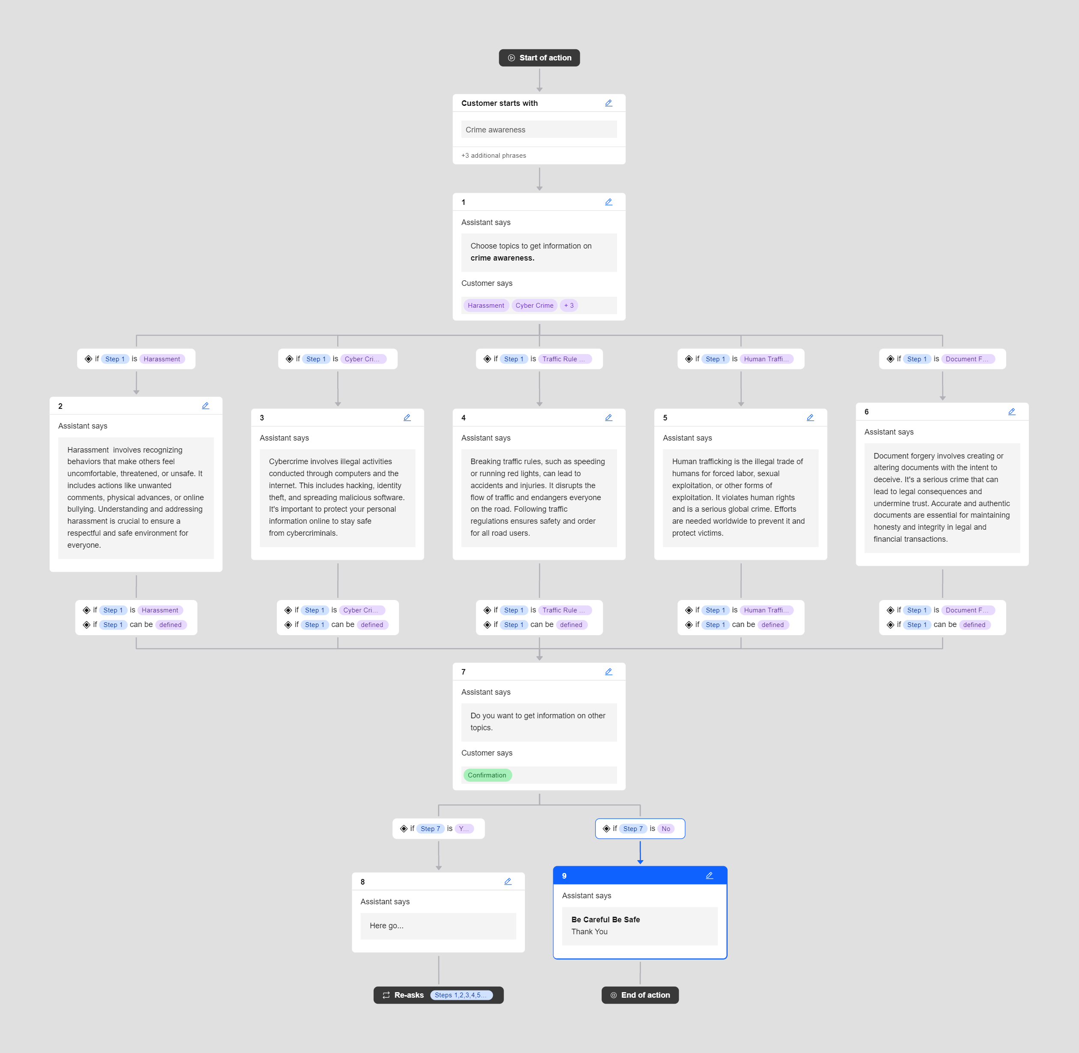
Result
Fig: Crime awareness

Slide 9
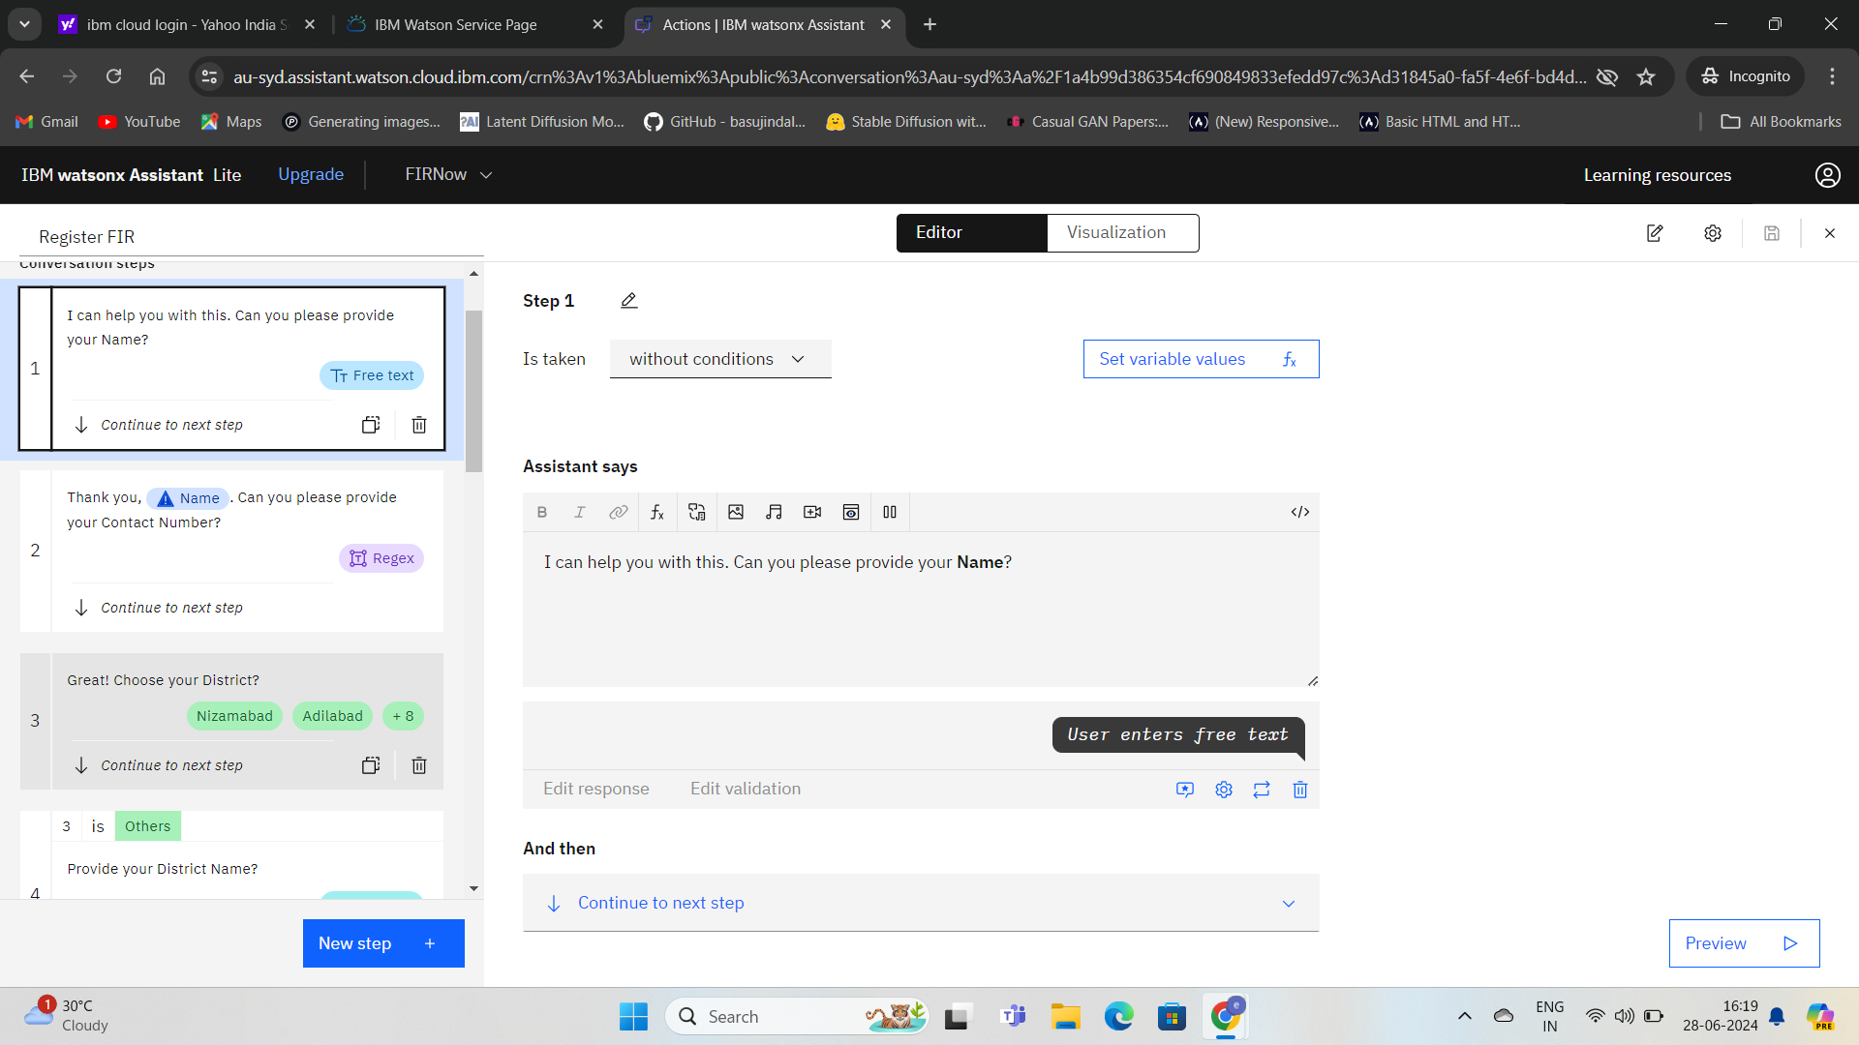
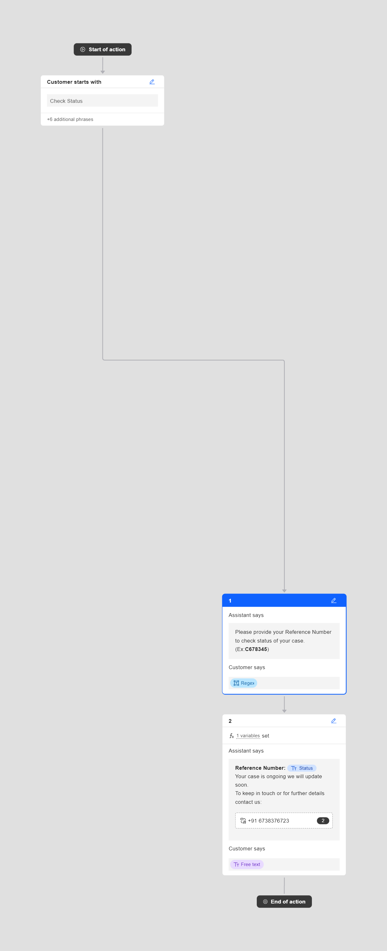
Result
Fig: Check Status
Fig: Register FIR

Slide 10
Conclusion
The implementation of the FIR registration and crime awareness chatbot using IBM Watson Assistant has successfully streamlined the process of filing FIRs and educating the public about various crimes. The chatbot's ability to understand and respond to user queries accurately has improved the overall user experience. This system not only makes it easier for people to report crimes but also helps to check status of FIR report and also by spreading awareness, which is crucial for crime prevention.

Slide 11
Future scope
Enhanced Features: Introduce additional features like real-time chat with police officers, emergency alerts, and location-based services.
Integration with Other Systems: Integrate the chatbot with other government and non-governmental systems for better coordination and response.
Multilingual Support: Integrating language translation features can make the chatbot accessible to a wider audience, including Villagers, thus diversifies globally.
Machine Learning: Implement advanced machine learning algorithms to improve the chatbot's understanding and responses over time.
Public Feedback: Collect and analyze user feedback to continuously improve the system and add features that users find helpful.

Slide 12
References
IBM watsonx Assistant tutorial
Youtube, Chatgpt
International journal of Innovative Research in Engineering & Management(ijirem)
www.ijirem.org

Slide 13
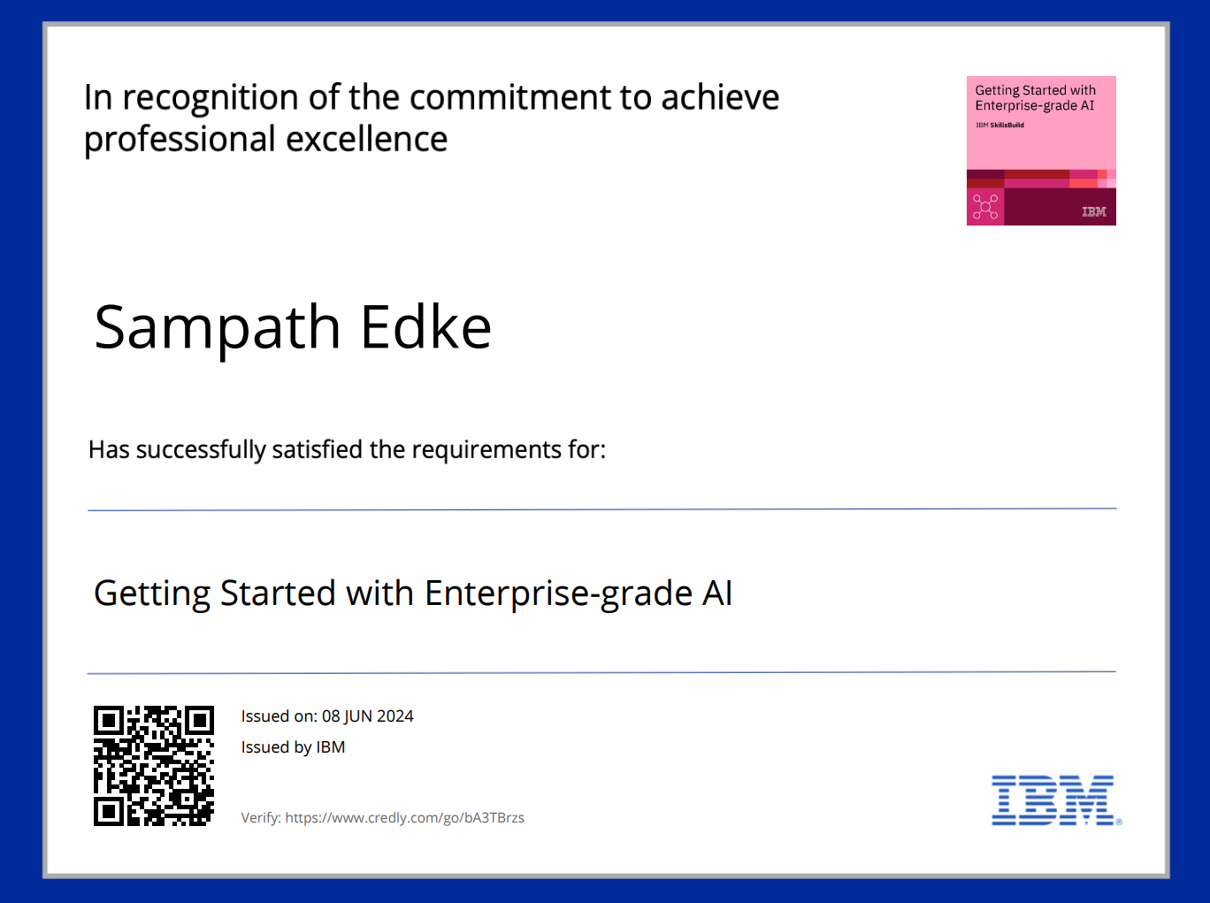
course certificate 1

Slide 14
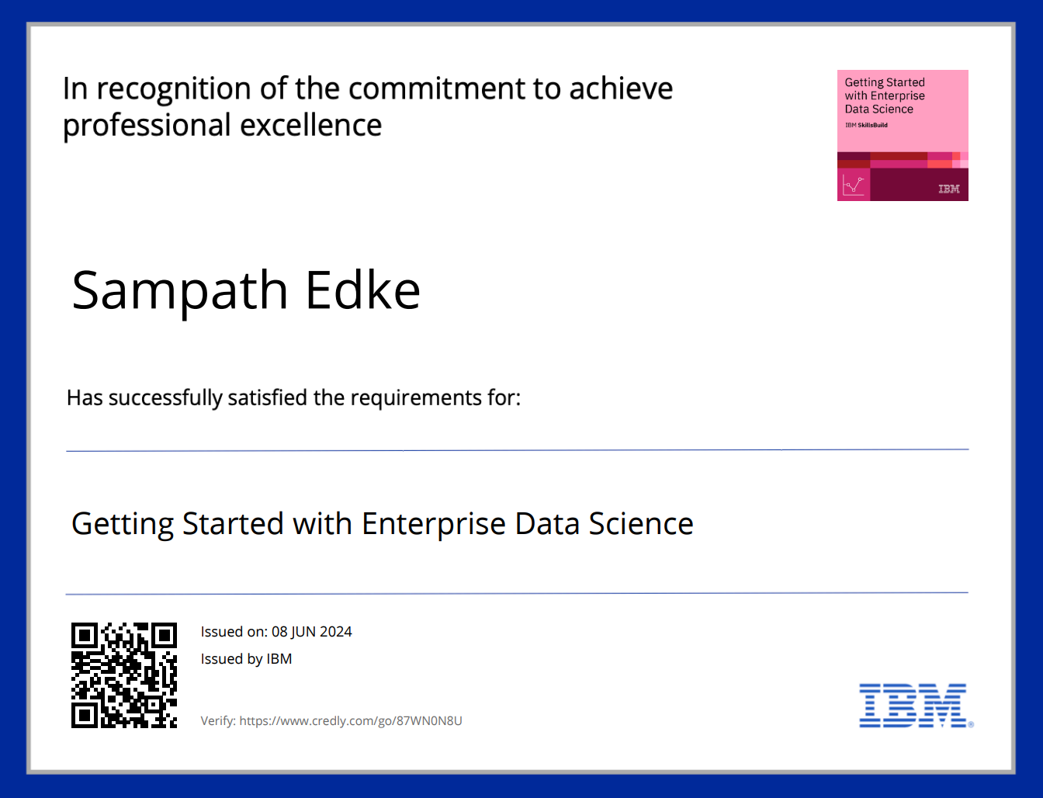
course certificate 2

Slide 15
THANK YOU

